Slide 1
Computer Security Principles
COMP6824001
Internet Security Protocols
Session 7

Slide 2
These slides have been adapted from:
Panek, Crystal. (2019). Security Fundamental, John Wiley & Sons, Inc. Indianapolis. ISBN: 978-1-119-65066-9
Lesson 3
Acknowledgement

Slide 3
Learning Objectives
LO1: To explain the security principles, threats, attacks and security strategy
LO2: To evaluate different strategies to handle security threats and attacks
LO3: To apply different techniques in handling computer and network security

Slide 4
Topics
OSI Model
MIME and S/MIME
Domain Keys Identified Mail (DKIM)
Secure Sockets Layer (SSL) and Transport Layer Security (TLS)
TLS Concepts-Alert Protocol
Handshake Protocol-Heartbeat Protocol
SSL/TLS Attacks
HTTPS -(HTTP over SSL)
IP Security (IPsec)-Security Associations
Transport and Tunnel Modes

Slide 5
These slides have been adapted from:
Panek, Crystal. (2019). Security Fundamental, John Wiley & Sons, Inc. Indianapolis. ISBN: 978-1-119-65066-9
Lesson 3
Acknowledgement

Slide 6
Learning Objectives
LO1: To explain the security principles, threats, attacks and security strategy
LO2: To evaluate different strategies to handle security threats and attacks
LO3: To apply different techniques in handling computer and network security

Slide 7
OSI Model
The open systems interconnection (OSI) model is a conceptual model created by the International Organization for Standardization which enables diverse communication systems to communicate using standard protocols (Cloudfare, 2022).
Each layer in the OSI layer has an interrelated function
Notes:
https://www.cloudflare.com/learning/ddos/glossary/open-systems-interconnection-model-osi/

Slide 8
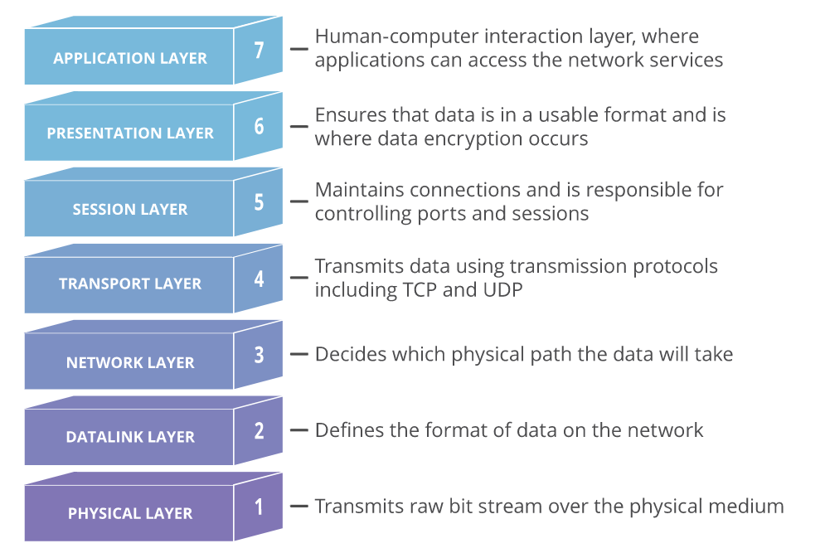
OSI Model
https://www.cloudflare.com/learning/ddos/glossary/open-systems-interconnection-model-osi/

Slide 9
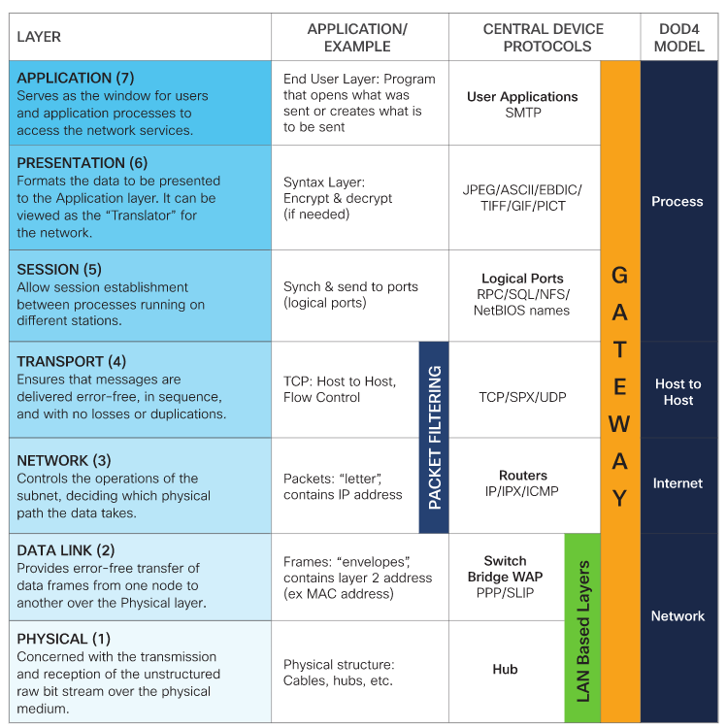
OSI Model
https://learningnetwork.cisco.com/s/contentdocument/0693i000001r6HTAAY

Slide 10
MIME and S/MIME
MIME is an extension to the old RFC 822 (Standard For The Format Of ARPA Internet TextMessages, 1982): specification of an Internet mail format.
RFC 822 defines a simple header withTo, From, Subject, and other fields that can be used to route an e-mail message through theInternet and that provides basic information about the e-mail content.
MIME defines a number of content formats, which standardize representations forthe support of multimedia e-mail. Examples include text, image, audio, and video.

Slide 11
MIME and S/MIME
S/MIME is a complex capability that is defined in a number of documents
  RFC 5750 (S/MIME Version 3.2 Certificate Handling, 2010): Specifies conventions for X.509certificate usage by (S/MIME) v3.2.
  RFC 5751 (S/MIME Version 3.2 Message Specification, 2010): The principal definingdocument for S/MIME message creation and processing.
  RFC 4134 (Examples of S/MIME Messages, 2005): Gives examples of message bodiesformatted using S/MIME.
  RFC 2634 (Enhanced Security Services for S/MIME, 1999): Describes four optional securityservice extensions for S/MIME.
  RFC 5652 (Cryptographic Message Syntax (CMS), 2009): The Cryptographic Message Syntaxis used to digitally sign, digest, authenticate, or encrypt arbitrary message content.
  RFC 3370 (CMS Algorithms, 2002): Describes the conventions for using several cryptographicalgorithms with the CMS.
  RFC 5752 (Multiple Signatures in CMS, 2010): Describes the use of multiple, parallelsignatures for a message.
  RFC 1847 (Security Multiparts for MIME—Multipart/Signed and Multipart/Encrypted, 1995):Defines a framework within which security services may be applied to MIME body parts. Theuse of a digital signature is relevant to S/MIME, as explained subsequently.

Slide 12
Domain Keys Identified Mail (DKIM)
DomainKeys Identified Mail (DKIM) is a specification for cryptographically signing e-mailmessages, permitting a signing domain to claim responsibility for a message in the mail stream.
Message recipients (or agents acting in their behalf) can verify the signature by querying thesigner’s domain directly to retrieve the appropriate public key and thereby can confirm that themessage was attested to by a party in possession of the private key for the signing domain.
DKIMis specified in Internet Standard RFC 4871 (DomainKeys Identified Mail (DKIM) Signatures,2007).
DKIM has been widely adopted by a range of e-mail providers, including corporations,government agencies, gmail, yahoo, and many Internet service providers (ISPs).

Slide 13
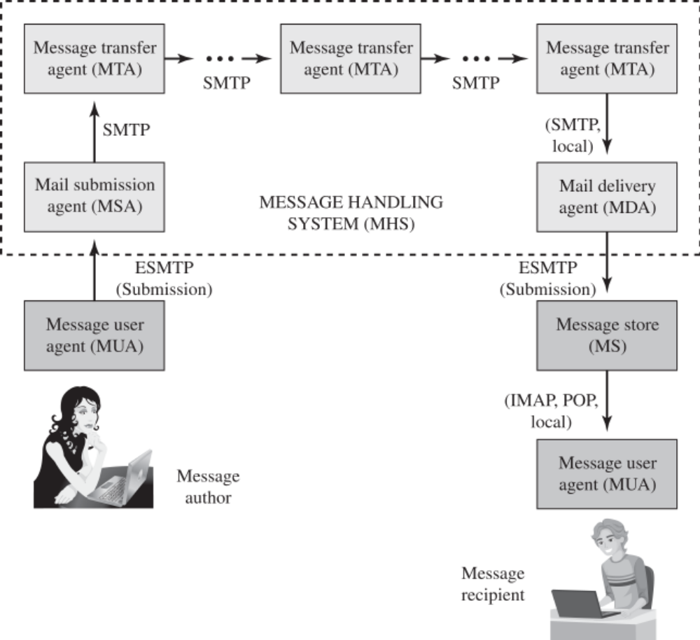
Domain Keys Identified Mail (DKIM)
Picture: Function Modules and Standardized Protocols Used Between Them in theInternet Mail Architecture (William Stalling, Computer Security,2018, Fig 22.2)

Slide 14
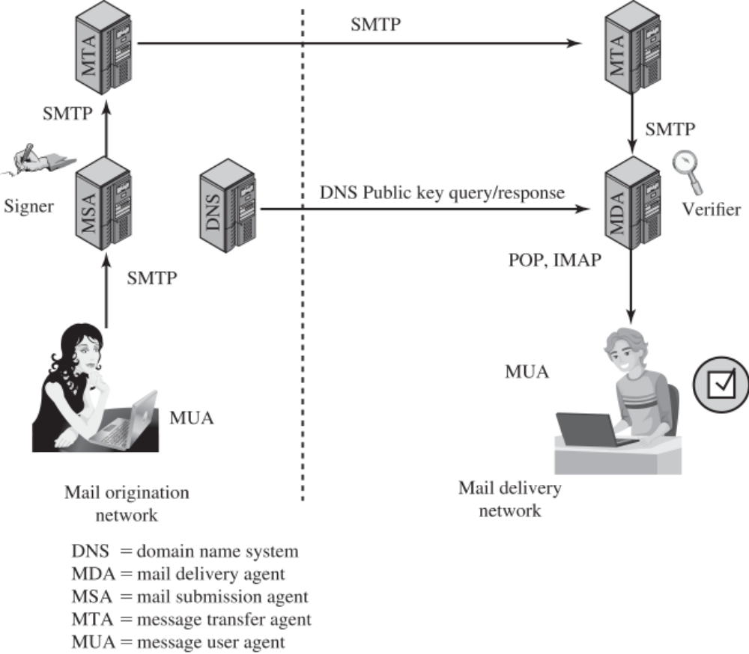
DKIM Strategy
Picture: Simple Example of DKIM Deployment, William stalling, Fig 22.3

Slide 15
Secure Sockets Layer (SSL) and Transport Layer Security (TLS)
One of the most widely used security services is the Secure Sockets Layer (SSL) and the follow-on Internet standard RFC 4346 (The Transport Layer Security (TLS) Protocol Version 1.1, 2006).
TLS has largely supplanted earlier SSL implementations.
TLS is a general-purpose serviceimplemented as a set of protocols that rely on TCP.

Slide 16
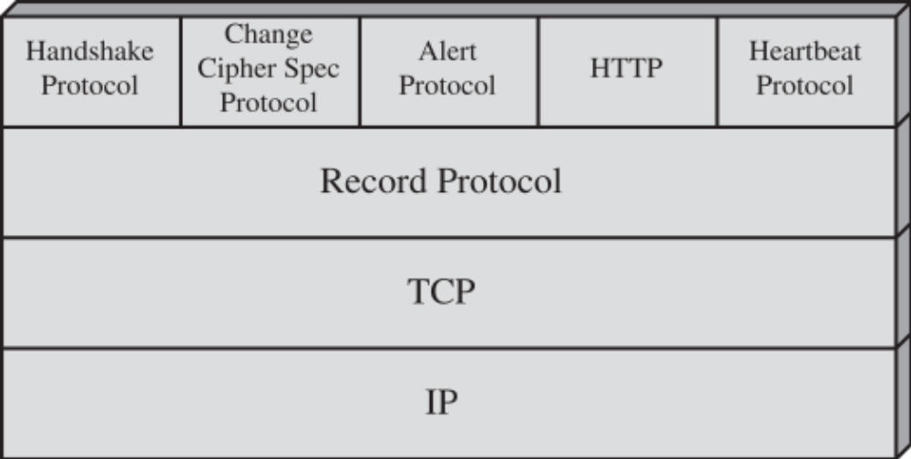
TLS Architecture
Picture: Figure 22.4 SSL/TLS Protocol Stack (William Stalling, 2018)

Slide 17
TLS Protocols
Record Protocol
Alert Protocol
Handshake Protocol
Heartbeat Protocol
Understanding Circuit-Level Firewalls

Slide 18
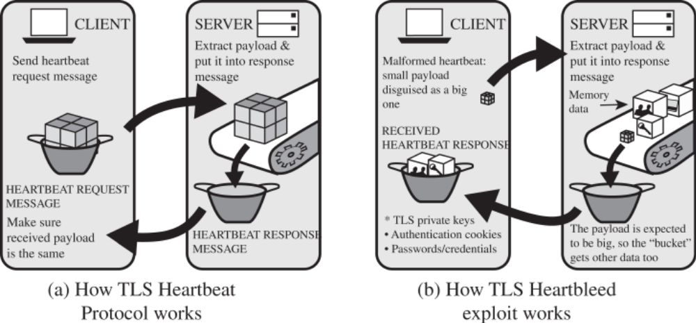
SSL/TLS Attacks
Picture: The Heartbleed Exploit (William Stalling, 2018, fig 22.7)

Slide 19
HTTPS
HTTPS (HTTP over SSL) refers to the combination of HTTP and SSL to implement securecommunication between a Web browser and a Web server
The principal difference seen by a user of a Web browser is that URL (uniform resource locator)addresses begin with https:// rather than http://. A normal HTTP connection uses port 80. IfHTTPS is specified, port 443 is used, which invokes SSL.
When HTTPS is used, the following elements of the communication are encrypted:
  URL of the requested document
  Contents of the document
  Contents of browser forms (filled in by browser user)
  Cookies sent from browser to server and from server to browser
  Contents of HTTP header

Slide 20
HTTPS
Connection Initiation
Connection Closure

Slide 21
IPv4 AND IPv6 SECURITY
IPsec is a group of protocols that are used together to set up encrypted connections between devices.
Users have some security concerns that cut across protocol layers
For example,an enterprise can run a secure, private TCP/IP network by disallowing links to untrusted sites,encrypting packets that leave the premises, and authenticating packets that enter the premises.By implementing security at the IP level, an organization can ensure secure networking not onlyfor applications that have security mechanisms but also for the many security-ignorantapplications.
IP-level security encompasses three functional areas:
  Authentication
  Confidentiality
  Keymanagement
Notes:
The authentication mechanism assures that a received packet was, in fact,transmitted by the party identified as the source in the packet header. In addition, this mechanismassures that the packet has not been altered in transit. The confidentiality facility enablescommunicating nodes to encrypt messages to prevent eavesdropping by third parties. The key management facility is concerned with the secure exchange of keys. The current version of IPsec,known as IPsecv3, encompasses authentication and confidentiality. Key management is providedby the Internet Key Exchange standard, IKEv2.
Sc: https://www.cloudflare.com/learning/network-layer/what-is-ipsec/

Slide 22
Applications of IPSec
Secure branch office connectivity over the Internet: A company can build a secure virtual private network over the Internet or over a public WAN. This enables a business to relyheavily on the Internet and reduce its need for private networks, saving costs and networkmanagement overhead.
Secure remote access over the Internet: An end user whose system is equipped with IPsecurity protocols can make a local call to an Internet service provider and gain secure accessto a company network. This reduces the cost of toll charges for traveling employees andtelecommuters.
Establishing extranet and intranet connectivity with partners: IPsec can be used tosecure communication with other organizations, ensuring authentication and confidentiality andproviding a key exchange mechanism.
Enhancing electronic commerce security: Even though some Web and electroniccommerce applications have built-in security protocols, the use of IPsec enhances thatsecurity.
Notes:
IPsec provides the capability to secure communications across a LAN, across private and publicWANs, and across the Internet

Slide 23
Transport and Tunnel Modes
Transport Mode
  -Transport Mode is a method of sending data over the Internet where the data is encrypted but the original IP address information is not.
  -Transport mode provides protection primarily for upper-layer protocols.
  -Transport modeprotection extends to the payload of an IP packet.
  -Typically, transport mode is usedfor end-to-end communication between two hosts (e.g., a client and a server, or two workstations).
Notes:
>>For example for transport mode:
Examples include a TCP or UDP segment,both of which operate directly above IP in a host protocol stack.
>>Other resource:
-https://www.hypr.com/security-encyclopedia/transport-mode#:~:text=Transport%20Mode%20is%20a%20method,Transport%20Mode%20or%20Tunnel%20Mode.
-https://www.ibm.com/docs/en/zos/2.2.0?topic=encapsulation-transport-mode-tunnel-mode
-https://docs.oracle.com/cd/E36784_01/html/E36838/ipsecov-13.html

Slide 24
TUNNEL MODE
Tunnel Mode is a method of sending data over the Internet where the data is encrypted and the original IP address information is also encrypted.
Tunnel mode provides protection to the entire IP packet
The entire original, inner, packet travels through atunnel from one point of an IP network to another; no routers along the way are able to examinethe inner IP header
Notes:
Resource:
https://www.hypr.com/security-encyclopedia/tunnel-mode#:~:text=Tunnel%20Mode%20is%20a%20method,address%20information%20is%20also%20encrypted.

Slide 25
Question ?

Slide 26
References
Panek, Crystal. (2019). Security Fundamental, John Wiley & Sons, Inc. Indianapolis. ISBN: 978-1-119-65066-9
Stallings, William and Lawrie Brown. 2018. Computer Security: Principles and Practice, 4th Edition. Global Edition, Pearson Education Limited
Notes:
Resources:
https://www.cloudflare.com/learning/ddos/glossary/open-systems-interconnection-model-osi/
https://www.cloudflare.com/learning/ddos/glossary/open-systems-interconnection-model-osi/
https://learningnetwork.cisco.com/s/contentdocument/0693i000001r6HTAAY
https://www.cloudflare.com/learning/network-layer/what-is-ipsec/
https://www.hypr.com/security-encyclopedia/transport-mode#:~:text=Transport%20Mode%20is%20a%20method,Transport%20Mode%20or%20Tunnel%20Mode.
https://www.ibm.com/docs/en/zos/2.2.0?topic=encapsulation-transport-mode-tunnel-mode
https://docs.oracle.com/cd/E36784_01/html/E36838/ipsecov-13.html
https://www.hypr.com/security-encyclopedia/tunnel-mode#:~:text=Tunnel%20Mode%20is%20a%20method,address%20information%20is%20also%20encrypted.

